Slide 1

Brake Failure Indicator for Safer Automotive Travel
By Group "Multimeter", Section: I

Slide 2
About Us
# | Name | ID
1 | Adnan Sami | 19-39676-1
2 | MD. Abu Hojifa | 21-45081-2
3 | MD. Omar Faruk Sakib | 21-45077-2
4 | Ashfat Ahmed Medul | 21-44854-2

Slide 3

Introduction
Name: Md. Omar Faruk Sakib
ID: 21-45077-2
This project aims to build a circuit that can monitor the brake wire of an automobile and provide an audio-visual feedback if the brake fails. This project can prevent accidents caused by brake failures.
Automobiles are a common mode of transportation, but brake failures can be dangerous.
A circuit can be built to monitor the continuity of the brake wire and alert the rider if there is a failure.
The circuit uses a 555 Timer IC and BC557 PNP Transistor to control LEDs and a buzzer.

Slide 4
Motivation
Name: Md. Omar Faruk Sakib
ID: 21-45077-2
Automobiles are our primary mode of transportation, and we depend on them for our day-to-day commute. Unfortunately, accidents happen, and brake failures are one such case. This project aims to prevent accidents caused by brake failures by providing an alert system to the driver.
Preventing accidents is important to ensure the safety of drivers, passengers, and pedestrians.
Brake failures can be caused by worn or cut brake wires, so monitoring the wire can help prevent accidents.
The circuit is simple and easy to build, making it accessible for DIY enthusiasts.

Slide 5
Aims & Objectives
Name: Md. Omar Faruk Sakib
ID: 21-45077-2
Aim:
The aim of this project is to build a circuit that can monitor the brake wire of an automobile and provide an audio-visual feedback if the brake fails. This project aims to prevent accidents caused by brake failures.
Objectives:
Develop a circuit to monitor brake wire continuity using a 555 Timer IC and BC557 PNP Transistor.
Implement a reliable system to accurately detect brake wire failures.
Integrate visual indicators (LEDs) and audible alerts (buzzer) for immediate driver feedback.
Design a robust, easily installable circuit compatible with various automobile models, while promoting awareness on the importance of brake wire monitoring.

Slide 6
Novelty
Name: Md. Omar Faruk Sakib
ID: 21-45077-2
This project's novelty lies in its simplicity and low cost. Most existing brake failure indicators are expensive and complicated. This project uses a 555 timer and a BC557 PNP transistor to build the circuit, making it affordable and easy to build.

Slide 7
Methodology
Name: Adnan Sami
ID: 19-39676-1
The circuit is built using a breadboard, 555 Timer IC, BC557 PNP Transistor, LEDs, buzzer, capacitors, and resistors.
The 555 Timer IC is set to Astable mode to produce a clock pulse with a 0.3 second on time and 0.3 second off time.
The value of the resistors and capacitor determine the on and off time of the pulse.
The BC557 PNP Transistor monitors the brake wire and controls the LEDs and buzzer based on its continuity.
When the brake wire is intact, the green LED is turned on and the buzzer and red LED are disconnected from ground and turned off.
When the brake wire is cut, the green LED is turned off and the buzzer and red LED are connected to ground and turned on, blinking and beeping based on the clock pulse.

Slide 8
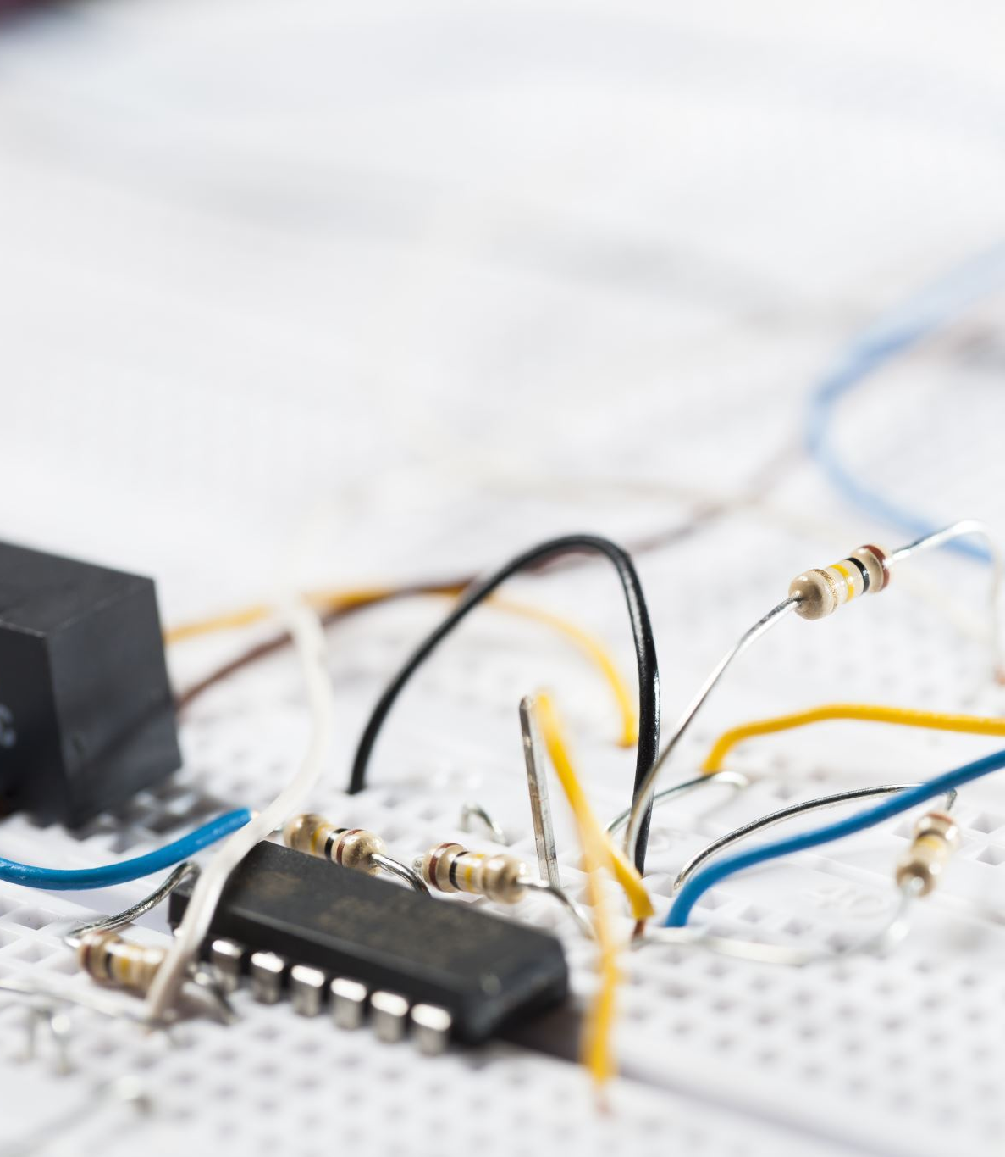
Apparatus
Name: Adnan Sami
ID: 19-39676-1
Breadboard
555 Timer IC
BC557 PNP Transistor
LEDs
Buzzer
Capacitors
Resistors

Slide 9
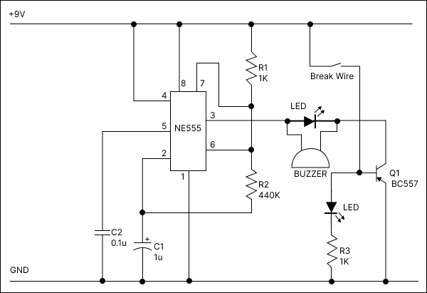
Block Diagram
Name: Adnan Sami
ID: 19-39676-1
Figure: Block Diagram of Brake Failure Indicator Circuit

Slide 10
Equations
Name: Adnan Sami
ID: 19-39676-1
The Astable mode in a 555 timer is commonly used to make LEDs blink or create a regular on and off pattern. For this project, we've configured the Timer to have an on time of 0.3 seconds and an off time of 0.3 seconds. The specific values of resistors along with capacitor determine how long the on and off periods last. By using these formulas, we can calculate the exact durations of the pulses generated. In our case the value for R1 = 1000ohm and R2=440000ohm and C1=0.000001F. So using these formulae we can calculate our values to be:
Resistor R1 (Ohm) | Resistor R2 (Ohm) | Capacitor C1 (F) | On Time T1 | Off Time T2 | Time Period T | Frequency F | Duty Cycle
1000 | 440000 | 0.000001 | 0.305613 | 0.30492 | 0.610533 | 1.6379131 | 0.5005675

Slide 11

Result & Discussion
Name: Ashfat Ahmed
ID: 21-44854-2
When the brake wire is in proper condition, the green LED lights up, and the buzzer and red LED remain off. When the brake wire is cut, the buzzer will make noise and red LED start flashing. The circuit is simple to build and provides an affordable and effective way to prevent accidents caused by brake failures.

Slide 12
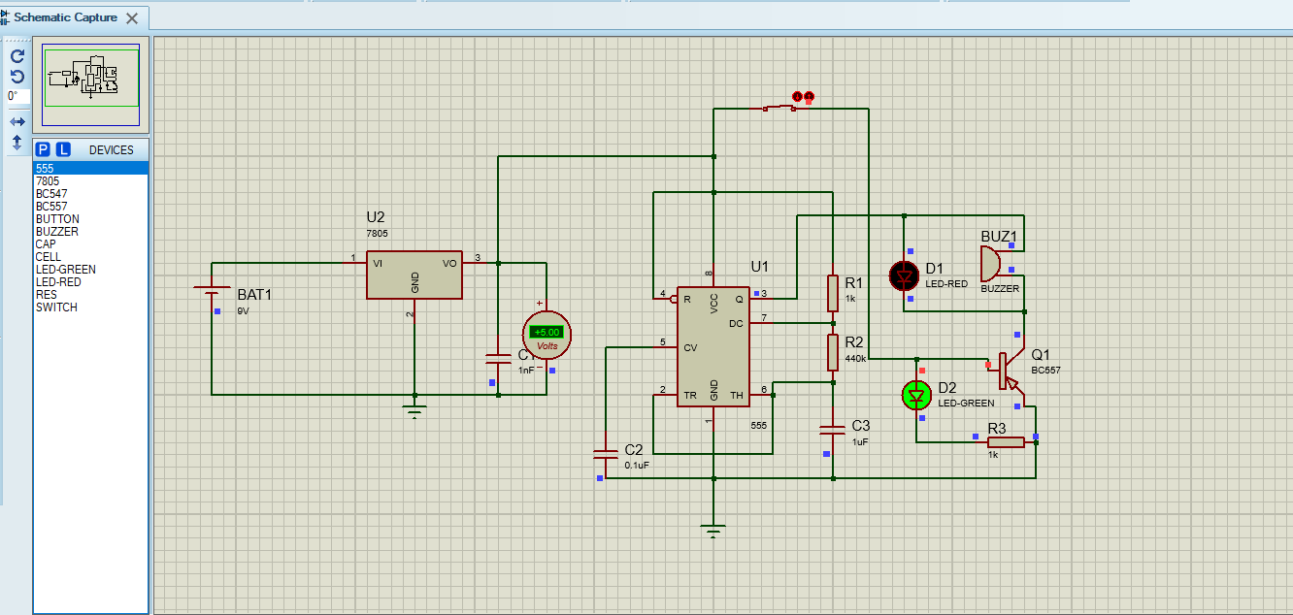
Simulation 1
Name: Ashfat Ahmed
ID: 21-44854-2
Figure 1: Brake OK

Slide 13
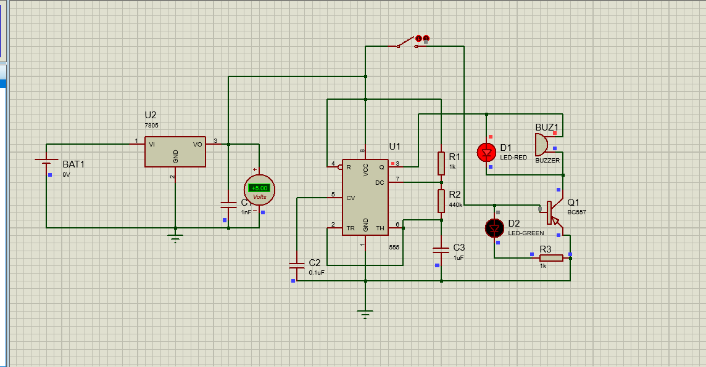
Simulation 2
Name: Ashfat Ahmed
ID: 21-44854-2
Figure 2: Brake Failed

Slide 14
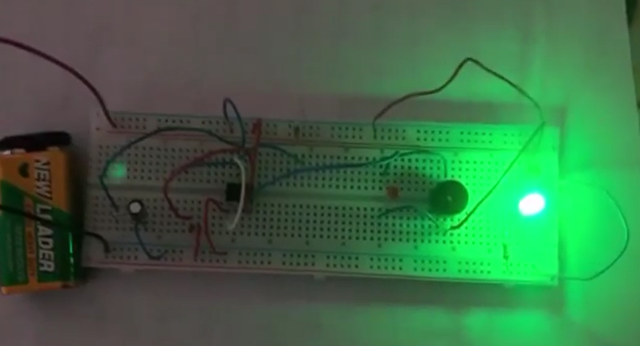
Hardware Prototype 1
Name: Ashfat Ahmed
ID: 21-44854-2
Figure 1: Brake OK

Slide 15
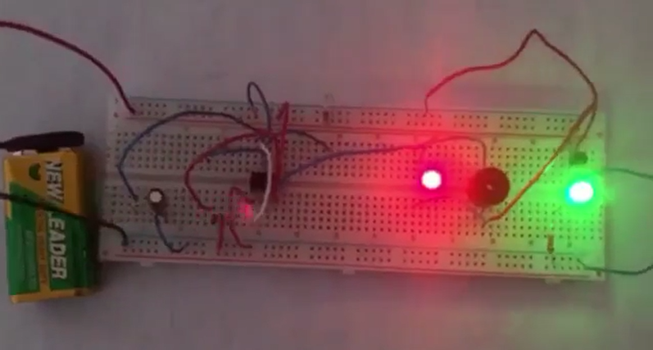
Hardware Prototype 2
Name: Ashfat Ahmed
ID: 21-44854-2
Figure 1: Brake Failed

Slide 16
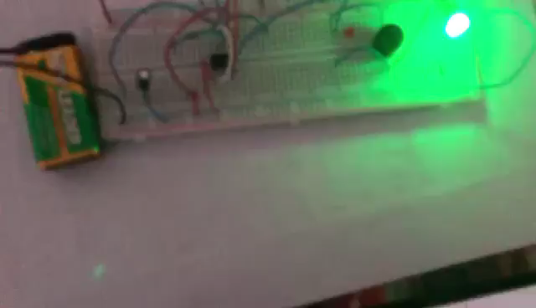
Hardware Prototype (Video)
Name: Ashfat Ahmed
ID: 21-44854-2

Slide 17
Project Cost
Name: Md. Abu Hojifa
ID: 21-45081-2
# | Name | Qty | Unit Price (BDT) | Net Price (BDT)
1 | 555 Timer | 1 | 18 | 18
2 | 0.1uf Capacitor | 1 | 2 | 2
3 | 1uf Capacitor | 2 | 2 | 4
4 | Buzzer | 1 | 22 | 22
5 | BC557 PNP transistor | 1 | 3 | 3
6 | LED | 2 | 2 | 4
7 | 1K Resistor | 2 | 2 | 4
8 | 470k Resistor | 1 | 3 | 3
9 | Jumper Wires | 1 | 70 | 70
10 | 9V Battery | 1 | 90 | 90
11 | Battery Clip | 1 | 20 | 20
12 | Bread Board | 1 | 155 | 155
 |  |  |  | Total = 395 BDT

Slide 18
Limitation
Name: Md. Abu Hojifa
ID: 21-45081-2
Power Supply.
Environmental Factors.
Sensitivity.
Compatibility.

Slide 19
Conclusion
Name: Md. Abu Hojifa
ID: 21-45081-2
In conclusion, this project provides an affordable and effective way to prevent accidents caused by brake failures. By building this circuit and attaching it to our vehicles, we can monitor the brake wire's continuity and be alerted if it fails. This project's simplicity and low cost make it accessible to anyone interested in building it.

Slide 20
References
Name: Md. Abu Hojifa
ID: 21-45081-2
Y.C. Venkatesh, A.S. Srikantappa, and P. Dinesh, "Smart Brake Monitoring System with Brake Failure Indication for Automobile Vehicles," in Proceedings of the IOP Conference Series: Materials Science and Engineering, vol. 852, no. 1, p. 012066, July 2020.
W.K. Lennon and K.M. Passino, "Intelligent control for brake systems," IEEE Transactions on Control Systems Technology, vol. 7, no. 2, pp. 188-202, 1999.
S. Saranya, M. Shankar, N. Muthulingam, and T. Sakthivarman, "Intelligent Automobile System for Accident prevention and detection," in Proceedings of the International Conference on Engineering Trends and Science & Humanities (ICETSH-2015), ISSN, pp. 2348-8549, May 2015.

Slide 21

Thank You
Name: Md. Abu Hojifa
ID: 21-45081-2

